Slide 1
Data Structures and Algorithms Tutorial 1 – Collections
Dr. Kok Hoe WONG

Slide 2
Topics:
Common data structures overview.
Use libraries
Collections
API check
Coding tasks and solution discussion – IntArrayBag

Slide 3
Common data structures
Array
Linked List
Stack
Queue
Binary Tree
Binary Search Tree
Heap
Hashing
Graph
…

Slide 4
Use Libraries
https://docs.oracle.com/en/java/javase/15/docs/api/index.html
There are two “groups” of interfaces, i.e. Collection’s and Map’s.

Slide 5
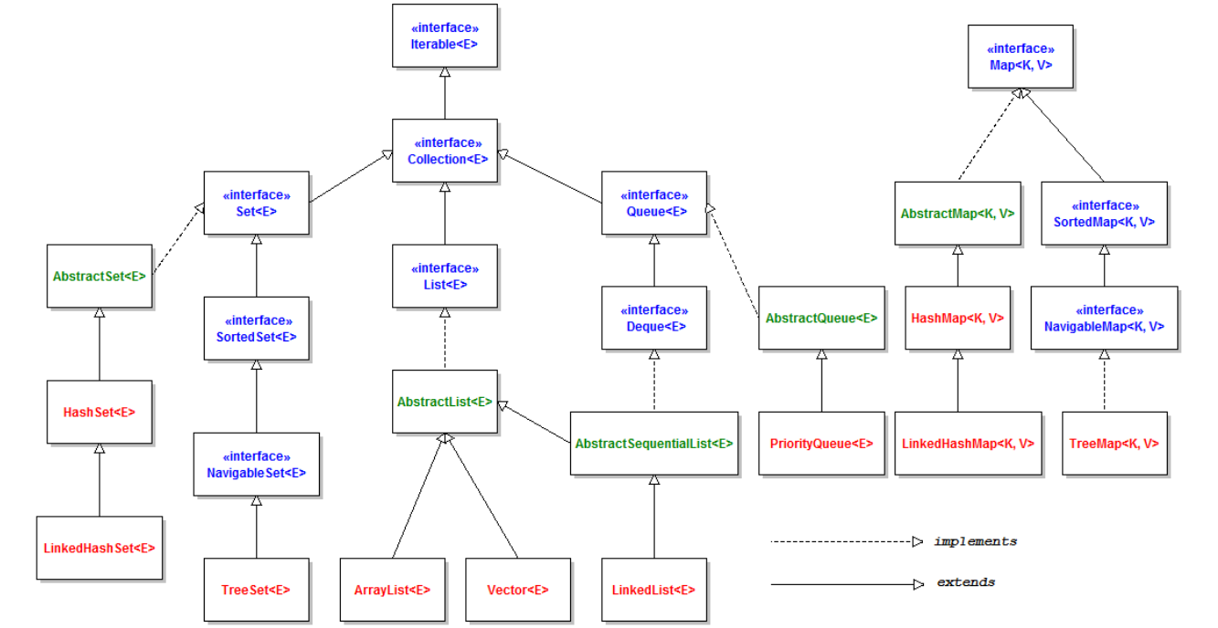

Slide 6
Coding tasks and solution discussion – IntArrayBag
Data stored: int
Data Structure used: Array
Abstract Data Type (ADT): Bag

Slide 7
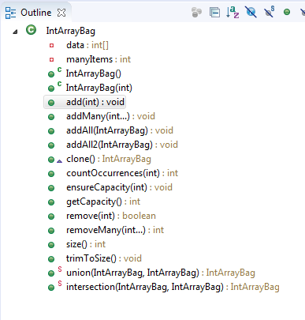

Slide 8
Task 1: Have a read of add(…) method and addMany(…) method. Use the similar idea to implement removeMany(…) method which allows user to remove many targets. Please use enhanced for loop.

Slide 9
Task 2: Have a read of union(…) method. Implement a method called intersection(…), which returns a new bag that contains the intersected elements from two other bags. Note: the number of appearance of the same element is the minimum number of the appearance of both bags. (Hint: Use Math.min(…) method.)

Slide 10
Task 3: You may notice that there are two methods : addAll(…) and addAll2(…) which seems to do the same task. The second method addAll2(…) is the wrong implementation, why?

